Slide 1
Data Science and Big Data Analytics

Slide 2
314453 : DATA SCIENCE AND BIG DATA ANALYTICS
Teaching Scheme:
Lectures: 4 Hours/Week
Credits 04
Examination Scheme:
In-Semester : 30 Marks
End-Semester: 70 Marks
Prerequisites:
Discrete Mathematics
Database management system
Data mining and Data warehousing

Slide 3
Course Objectives
To introduce basic need of Big Data and Data science to handle huge amount of data.
To understand the basic mathematics behind the Big data.
To understand the different Big data processing techniques.
To understand and apply the Analytical concept of Big data using R.
To visualize the Big Data using different tools.
To understand the application and impact of Big Data.

Slide 4
Course Outcomes
By the end of the course, students should be able to
Students will be able to outline Big Data learning primitives.
Students will be able to learn and Apply different mathematical models behind Big Data.
Students will be able to demonstrate their Big Data learning skills by developing industry or research applications.
Students will be able to analyze each learning model come from a different algorithmic approach and it will perform differently under different datasets.

Slide 5
Syllabus
UNIT – I INTRODUCTION: DATA SCIENCE AND BIG DATA (08 hours)
Introduction to Data science and Big Data, Defining Data science and Big Data, Big Data examples, Data explosion, Data volume, Data Velocity, Big data infrastructure and challenges, Big Data Processing Architectures, Data Warehouse, Re-Engineering the Data Warehouse, Shared everything and shared nothing architecture, Big data learning approaches.
UNIT – II MATHEMATICAL FOUNDATION OF BIG DATA (08 Hours)
Probability theory, Tail bounds with applications, Markov chains and random walks, Pair wise independence and universal hashing, Approximate counting, Approximate median, The streaming models, Flajolet Martin Distance sampling, Bloom filters, Local search and testing connectivity, Enforce test techniques, Random walks and testing, Boolean functions, BLR test for linearity.

Slide 6
Syllabus (Cont…)
UNIT - III BIG DATA PROCESSING (08 Hours)
Big Data technologies, Introduction to Google file system, Hadoop Architecture, Hadoop Storage: HDFS, Common Hadoop Shell commands, Anatomy of File Write and Read, NameNode, Secondary NameNode, and DataNode, Hadoop MapReduce paradigm, Map Reduce tasks, Job, Task trackers - Cluster Setup – SSH & Hadoop Configuration, Introduction to: NOSQL, Textual ETL processing.
UNIT – IV BIG DATA ANALYTICS (08 Hours)
Data analytics life cycle, Data cleaning , Data transformation, Comparing reporting and analysis, Types of analysis, Analytical approaches, Data analytics using R, Exploring basic features of R, Exploring R GUI, Reading data sets, Manipulating and processing data in R, Functions and packages in R, Performing graphical analysis in R, Integrating R and Hadoop, Hive, Data analytics.

Slide 7
Syllabus (Cont…)
UNIT – V Big Data Visualization (08 Hours)
Introduction to Data visualization, Challenges to Big data visualization, Conventional data visualization tools, Techniques for visual data representations, Types of data visualization, Visualizing Big Data, Tools used in data visualization, Propriety Data Visualization tools, Open –source data visualization tools, Analytical techniques used in Big data visualization, Data visualization with Tableau, Introduction to: Pentaho, Flare, Jasper Reports, Dygraphs, Datameer Analytics Solution and Cloudera, Platfora, NodeBox, Gephi, Google Chart API, Flot, D3, and Visually.
UNIT – VI BIG DATA TECHNOLOGIES APPLICATION AND IMPACT (08 Hours)
Social media analytics, Text mining, Mobile analytics , Roles and responsibilities of Big data person, Organizational impact, Data analytics life cycle, Data Scientist roles and responsibility, Understanding decision theory, creating big data strategy, big data value creation drivers, Michael Porter’s valuation creation models, Big data user experience ramifications, Identifying big data use cases.

Slide 8
Text Books
1. Krish Krishnan, Data warehousing in the age of Big Data, Elsevier, ISBN: 9780124058910, 1st Edition.
2. DT Editorial Services, Big Data, Black Book, DT Editorial Services, ISBN: 9789351197577, 2016 Edition.

Slide 9
Reference Books
1. Mitzenmacher and Upfal, Probability and Computing: Randomized Algorithms and Probabilistic Analysis, Cambridge University press, ISBN :521835402 hardback.
2. Dana Ron, Algorithmic and Analysis Techniques in Property Testing, School of EE.
3. Graham Cormode, Minos Garofalakis, Peter J. Haas and Chris Jermaine, Synopses for Massive Data: Samples, Histograms, Wavelets, Sketches, Foundation and trends in databases, ISBN :10.1561/1900000004.
4. A.Ohri, R for Business Analytics, Springer, ISBN:978-1-4614-4343-8.
5. Alex Holmes, Hadoop in practice, Dreamtech press, ISBN:9781617292224.
6. AmbigaDhiraj, Big Data, Big Analytics: Emerging Business Intelligence and Analytic Trends for Today’s Business, Wiely CIO Series.
7. Arvind Sathi, Big Data Analytics: Disruptive Technologies for Changing the Game, IBM Corporation, ISBN:978-1-58347-380-1.

Slide 10
Reference Books (Cont…)
8. EMC Education Services, Data Science and Big Data Analytics- Discovering, analyzing Visualizing and Presenting Data.
9. Li Chen, Zhixun Su, Bo Jiang, Mathematical Problems in Data Science, Springer, ISBN :978-3-31925127-1.
10. Philip Kromer and Russell Jurney, Big Data for chips, O’Reilly, ISBN :9789352132447.
11. EMC Education services, Data Science and Big Data Analytics, EMC2 Wiley, ISBN :9788126556533.
12. Mueller Massaron, Python for Data science, Wiley, ISBN :9788126557394.
13. EMC Education Services, Data Science and Big Data Analytics, Wiley India, ISBN: 9788126556533
14. Benoy Antony, Konstantin Boudnik, Cheryl Adams,,Professional Hadoop, Wiley India, ISBN :9788126563029
15. Mark Gardener, Beginning R: The Statistical Programming Language ,Wiley India, ISBN :9788126541201
16. Mark Gardener, The Essential R Reference ,Wiley India, ISBN : 9788126546015
17. Judith Hurwitz, Alan Nugent, Big Data For Dummies, Wiley India, ISBN : 9788126543281

Slide 11
UNIT – I Introduction: Data Science and Big Data
.

Slide 12
Big Data: Introduction
Big Data is large volume of Data in structured or unstructured form.
The rate of data generation has increased exponentially by increasing use of data intensive technologies.
Processing or analyzing the huge amount of data is a
challenging task.
It requires new infrastructure and a new way of thinking about the way business and IT industry works

Slide 13

What is Big Data?
The are many examples of "data", but what makes some of it “big”? The classic definition revolves around the three Vs.
Volume, velocity, and variety.
Volume: There is a just a lot of it being generated all the time. Things get interesting and “big”, when you can’t fit it all on one computer anymore. Why? There are many ideas here such as MapReduce, Hadoop, etc. that all revolve around being able to process data that goes from Terabytes, to Petabytes, to Exabytes.
Velocity: Data is being generated very quickly. Can you even store it all? If not, then what do you get rid of and what do you keep?
Variety: The data types you mention all take different shapes. What does it mean to store them so that you can play with or compare them?
http://pl.wikipedia.org/wiki/Green_Giant#mediaviewer/Plik:Jolly_green_giant.jpg

Slide 14
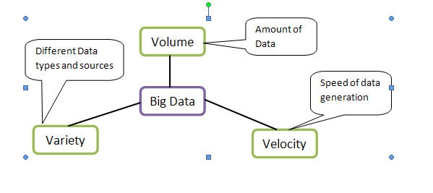
Defining Big Data

Slide 15
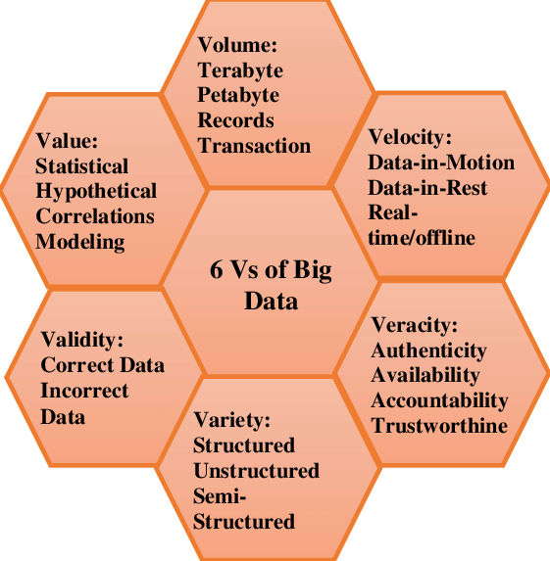
6 V’s of Big Data

Slide 16
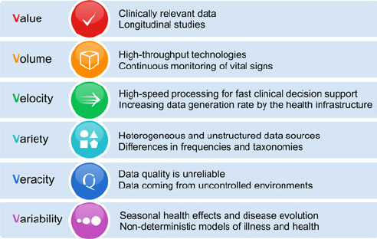
Case study: 6 V’s in clinical dataset

Slide 17
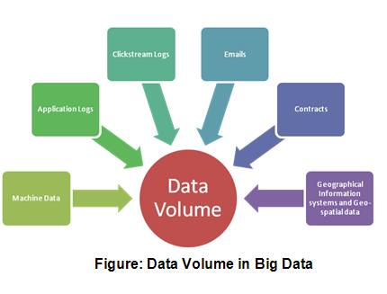
Data Volume

Slide 18
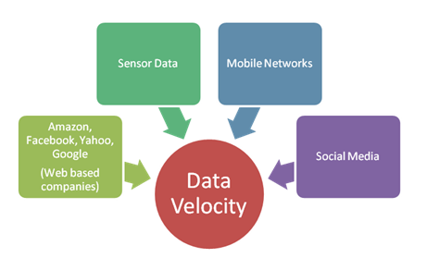
Data Velocity

Slide 19
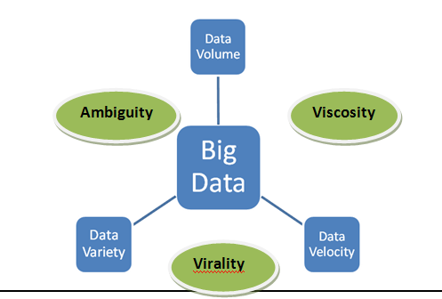
Data Variety
Ambiguity -- Uncertainty
Viscosity – It is the inertia when navigating through a data collection.
Virality – measures the speed at which data can spread through a network.

Slide 20
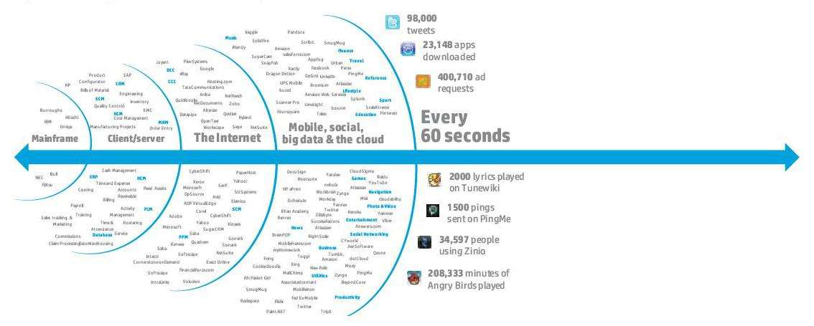
Problem of Data Explosion

Slide 21
Problem of Data Explosion (Cont…)
The International Data Corporation (IDC) study predicts that overall data will grow by 50 times by 2020.
The digital universe is 1.8 trillion gigabytes (109) in size and stored in 500 quadrillion (1015) files.
Information Bits in the digital universe as stars in our physical universe.
90% Data is in unstructured form.

Slide 22
Issues in Big Data
Issues related to the Characteristics
Storage and Transfer Issues
Data Management Issues
Processing Issues

Slide 23
Issues related to the Characteristics
Data Volume Issues
Data Velocity Issues
Data Variety Issues
Worth of Data Issues
Data Complexity Issues

Slide 24
Storage and Transfer Issues
Current Storage Techniques and Storage Medium are not appropriate for effectively handling Big Data.
Current Technology limits 4 Terabytes (1012) per disk, so1 Exabyte (1018) size data will take 25,000 Disks.
Accessing that data will also overwhelm network.
Assuming a sustained transfer of 1 Exabyte will take 2,800 hours with a 1 Gbps capable network with 80% effective transfer rate and 100Mbps sustainable speed.

Slide 25
Data Management Issues
Resolving issues of access, utilization, updating, governance, and reference (in publications) have proven to be major stumbling blocks.
In such volume, it is impractical to validate every data item.
New approaches and research to data qualification and validation are needed.
The richness of digital data representation prohibits a personalized methodology for data collection.

Slide 26
Processing Issues
The Processing Issues are critical to handle.
Example: 1 Exabyte = 1000 Petabytes (1015). Assuming a processor expends 100 instructions on one block at 5 gigahertz, the time required for end to-end processing would be 20 nanoseconds. To process 1K petabytes would require a total end-to-end processing time of roughly 635 years.
Effective processing of Exabyte of data will require extensive parallel processing and new analytics algorithms

Slide 27
Challenges in Big Data
Privacy and Security
Data Access and Sharing of Information
Analytical Challenges
Human Resources and Manpower
Technical Challenges

Slide 28
Privacy and Security
Privacy and Security are sensitive and includes conceptual, Technical as well as legal significance.
Most Peoples are vulnerable to Information Theft.
Privacy can be compromised in the large data sets.
The Security is also critical to handle in such large data.
Social stratification would be important arising consequence.

Slide 29
Data Access and Sharing of Information
Data should be available in accurate, complete and timely manner.
The data management and governance process bit complex adding the necessity to make data open and make it available to government agencies.
Expecting sharing of data between companies is awkward.

Slide 30
Analytical Challenges
Big data brings along with it some huge analytical challenges.
Analysis on such huge data, requires a large number of advance skills.
The type of analysis which is needed to be done on the data depends highly on the results to be obtained.

Slide 31
Human Resources and Manpower
Big Data needs to attract organizations and youth with diverse new skill sets.
The skills includes technical as well as research, analytical, interpretive and creative ones.
It requires training programs to be held by the organizations.
Universities need to introduce curriculum on Big data.

Slide 32
Technical Challenges
Fault Tolerance: If the failure occurs the damage done should be within acceptable threshold rather than beginning the whole task from the scratch.
Scalability: Requires a high level of sharing of resources which is expensive and dealing with the system failures in an efficient manner.
Quality of Data: Big data focuses on quality data storage rather than having very large irrelevant data.
Heterogeneous Data: Structured and Unstructured Data.

Slide 33
Advantages of Big Data
Understanding and Targeting Customers
Understanding and Optimizing Business Process
Improving Science and Research
Improving Healthcare and Public Health
Optimizing Machine and Device Performance
Financial Trading
Improving Sports Performance
Improving Security and Law Enforcement

Slide 34
Some Projects using Big Data
Amazon.com handles millions of back-end operations and have 7.8 TB, 18.5 TB, and 24.7 TB Databases.
Walmart is estimated to store more than 2.5 PB Data for handling 1 million transactions per hour.
The Large Hadron Collider (LHC) generates 25 PB data before replication and 200 PB Data after replication.
Sloan Digital Sky Survey ,continuing at a rate of about 200 GB per night and has more than 140 TB of information.
Utah Data Center for Cyber Security stores Yottabytes (1024).

Slide 35
Is Big Data the same as Data Science?
Are Big Data and Data Science the same thing?
I wouldn't say so...
Data Science can be done on small data sets.
And not everything done using Big Data would necessarily be called Data Science.
Big Data
Data
Science

Slide 36
Is Big Data the same as Data Science?
Are Big Data and Data Science the same thing?
I wouldn't say so...
Data Science can be done on small data sets.
And not everything done using Big Data would necessarily be called Data Science.
But there certainly is a substantial overlap!
Big Data
Data
Science

Slide 37
Big Data Infrastructure: Hadoop/MapReduce Programming & Data Processing
Architecture of Hadoop, HDFS, and Yarn
Programming on Hadoop
Basic Data Processing: Sort and Join
Information Retrieval using Hadoop
Data Mining using Hadoop (Kmeans+Histograms)
Machine Learning on Hadoop (EM)
Hive/Pig
HBase and Cassandra

Slide 38
Big Data Learning Approaches
Classical Approach
Given
Wanted
Model
Input
Output
Machine Learning Approach
Model
Input
Output

Slide 39
How Machine Learning Works
Machine Learning builds a model from the data
Supervised: Data and Labels
Unsupervised: Data with no label
The model is used then to:
Predict the outcome of a system
Recognize complicated patterns in the new data points
Classify inputs

Slide 40
Big Data Processing Examples
Weather data
Contract Data
Financial reporting data
Clinical trials data
Social Media posts
Survey data

Slide 41
Big Data processing Architectures
Centralized Processing
Distributed Processing
Client Server Architecture
Cluster Architecture
Advantages of distributed processing are scalability, customization of processing and management of information based on operation, and parallel processing of data which reduce latencies.
Disadvantages of distributed processing are data redundancy, process redundancy, resource overhead and volume.

Slide 42
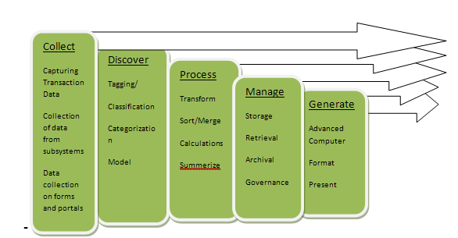
Big Data Processing Cycle

Slide 43
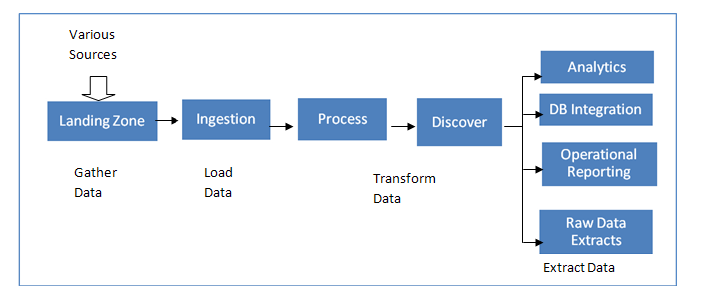
Big Data Processing Flow

Slide 44
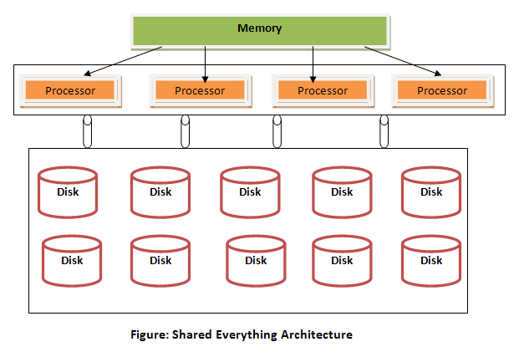
Shared everything Architectures

Slide 45
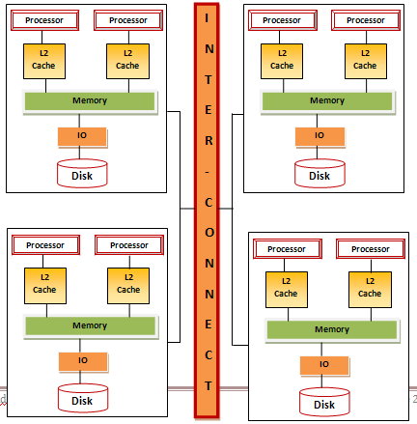
Shared nothing Architectures

Slide 46
The requirements for Big Data infrastructure and Processing Architecture
Data Processing Requirements:
Data- Model less architecture
Micro batch Processing
Data collection in real time
Minimal Data transformation
Multi partition Capability
Efficient Data Reads
Share data across multiple processing points
Store results in File system or non-relational DBMS

Slide 47
Infrastructure Requirements
Linear Scalability
High Throughput
Fault Tolerant
Auto recovery
Distributed Data processing
High degree of parallelism
Programming language interface

